Slide 1

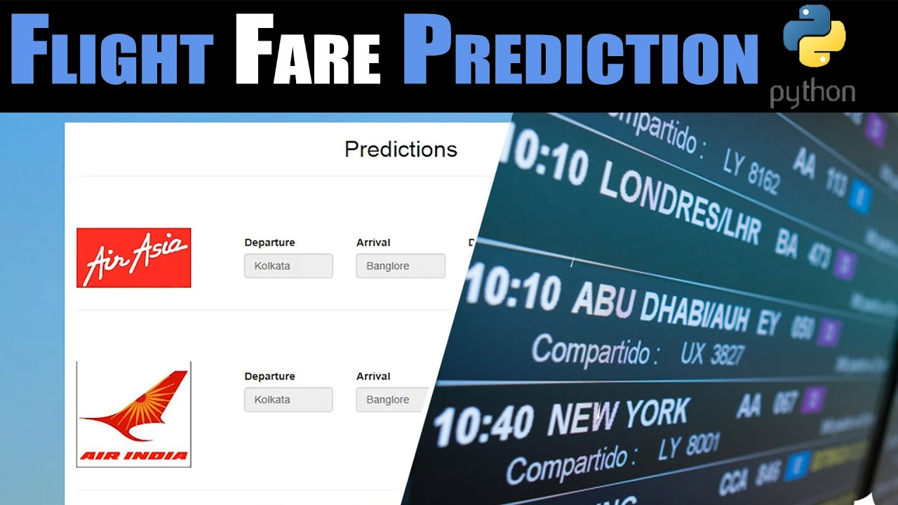
Flight Price Prediction
Submitted By:- Ojasav Sahu
Internship: 23

Slide 2
Table of Content
Data Sources
Introduction
Analytical Problem Framing
Data Analysis
Data Sources
Analysis
Statistical Description of the Data
Pre-Processing
Visualization
Label Encoder
Principal Component Analysis
Treating the Outliers
Treating the Skewness
Scaling the Data
Model Building
Limitations & Scope For Future

Slide 3
Introduction
Anyone who has booked a flight ticket knows how unexpectedly the prices vary. The cheapest available ticket on a given flight gets more and less expensive over time. This usually happens as an attempt to maximize revenue based on –
Time of purchase patterns (making sure last-minute purchases are expensive)
Keeping the flight as full as they want it (raising prices on a flight which is filling up in order to reduce sales and hold back inventory for those expensive last-minute expensive purchases)
So, you have to work on a project where you collect data of flight fares with other features and work to make a model to predict fares of flights.

Slide 4
Analytical Problem Framing
In this analysis, we will be predicting the flight price for various class in domestic flights
Using this as a base, I have collected the data from few websites. The data was collected the period of two weeks. I have included various features like flight class, duration, number of stops between destination and so on
Once the data is collected, we will extract features from it, the data will be cleaned and pre-processed with all the necessary tools and the same will be used to build machine learning models in order to predict the price of the same

Slide 5
Data Analysis
The dataset has 1746 rows and 9 columns. Using this dataset we will be training the Machine Learning models on 70% of the data and the models will be tested on 30% data.
There are no missing values in the dataset. However, I can expect outliers and un-realistic values for certain variables.
I’m extracting features like day of week, sessions in a day (i.e., morning, afternoon, night and so on), month, day, departure hour, departure minute and total duration in minutes.

Slide 6
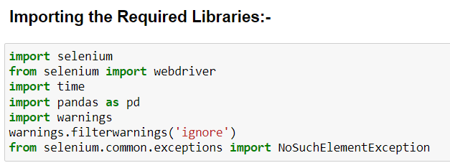
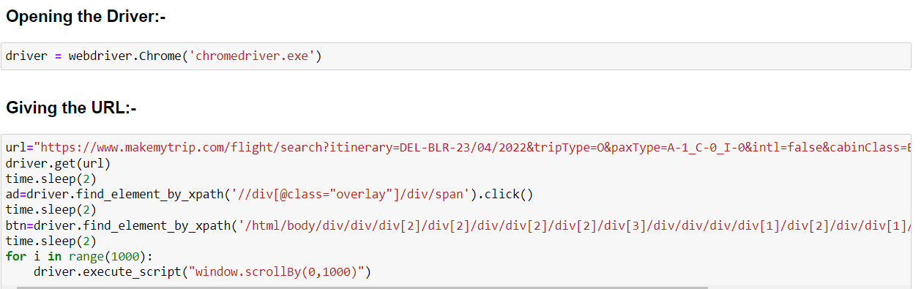
Data Sources:-
The data is scrapped and collected from the website mentioned below:
https://www.yatra.com/
https://www.makemytrip.com

Slide 7
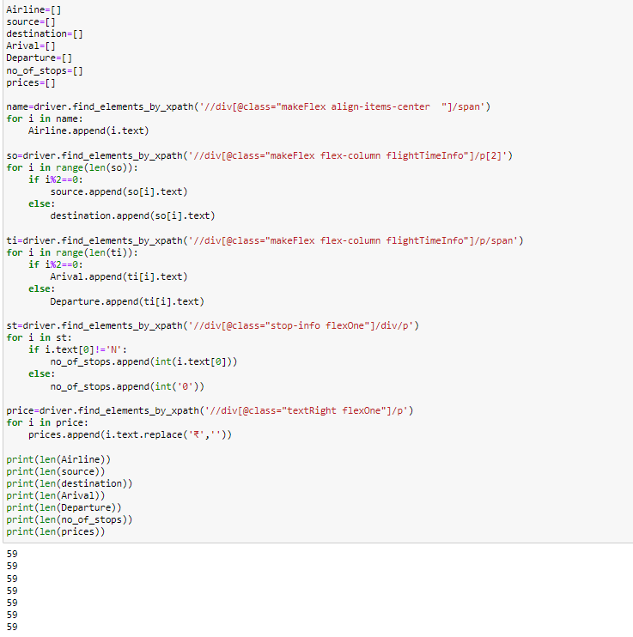
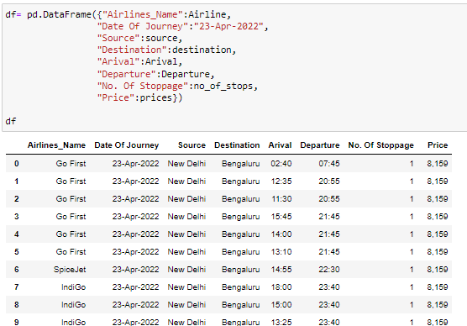
I have done the same thing again and again, by changing the Data of Journey and also by changing the Location and then I have merged all the DataFrame and made one csv file, I have repeated this process again and again, till the time, I got mine sufficient data for model building.
Once, I have scrapped enough data, Then after that On a Fresh Jupyter Notebook I have started to build the model.
Here, I have printed the length for each of the columns, that I have extracted. So, that I can be sure that no data is mismatched, and the DataFrame can be formed easily.

Slide 8
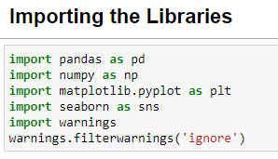
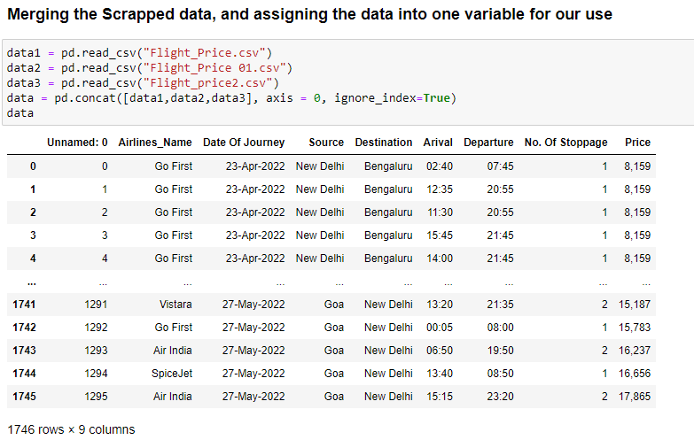
Analysis

Slide 9
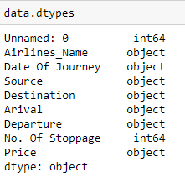
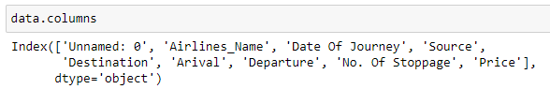
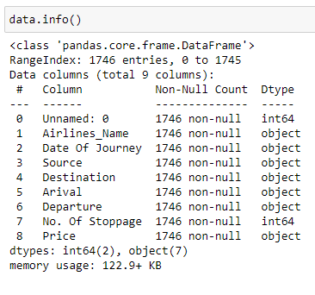

Slide 10
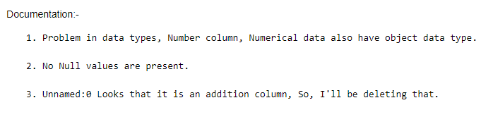
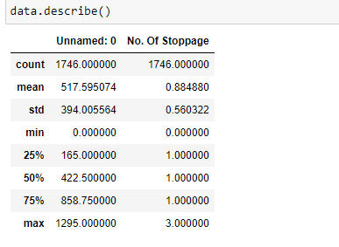
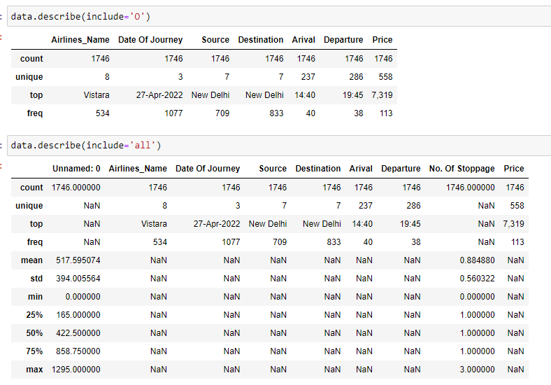
Statistical Description of the Data

Slide 11
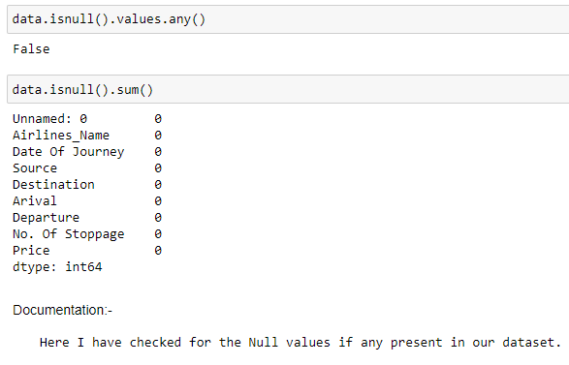
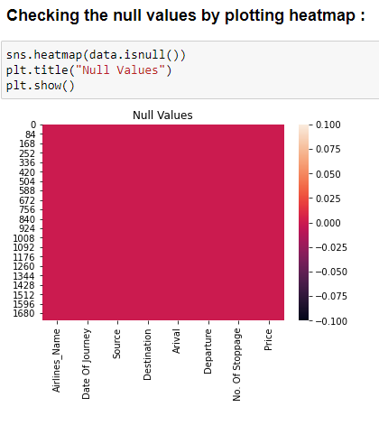
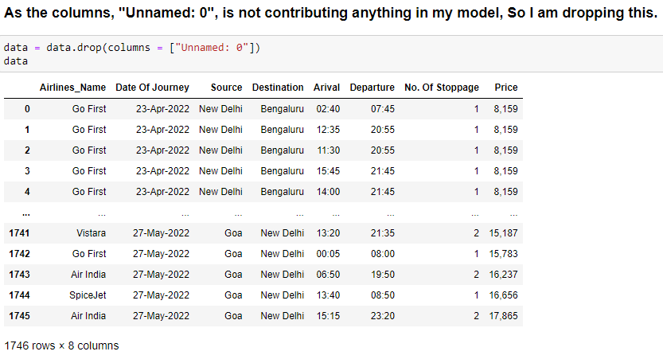

Slide 12
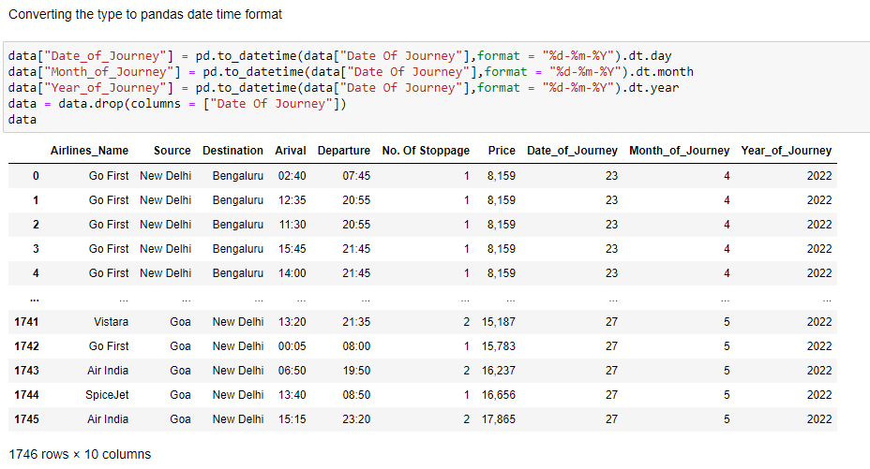
Pre-Processing

Slide 13
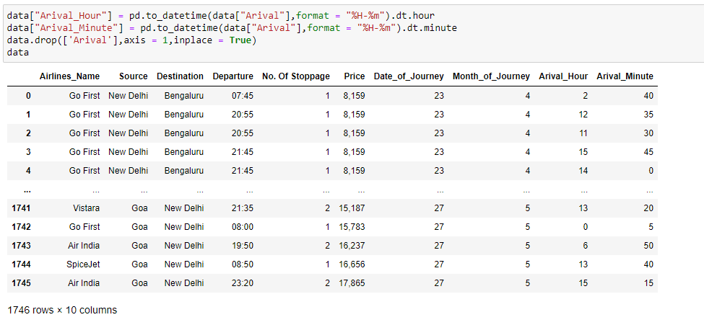

Slide 14
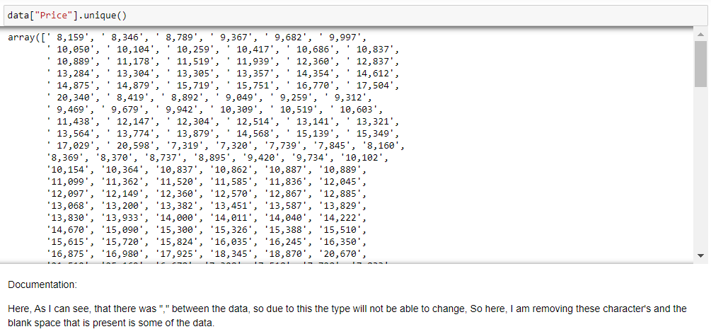
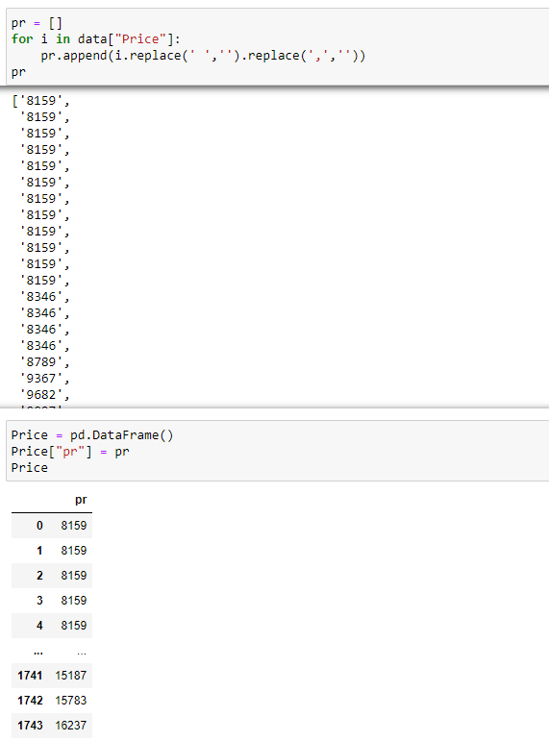

Slide 15
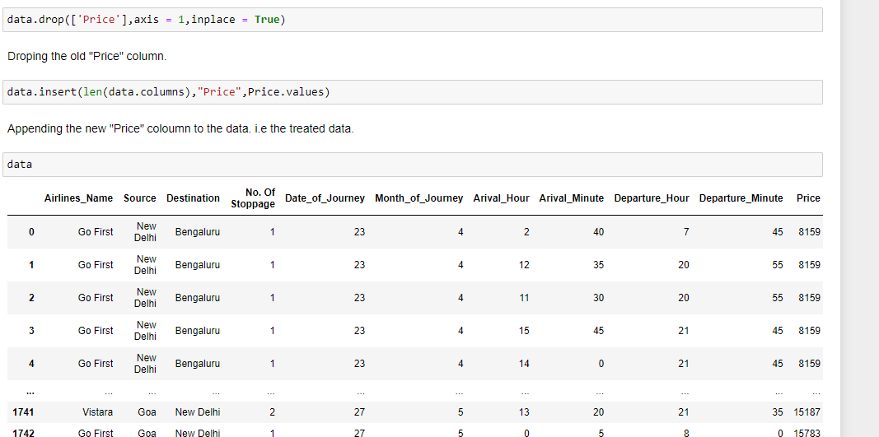
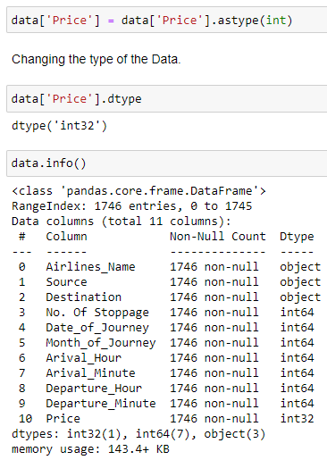

Slide 16
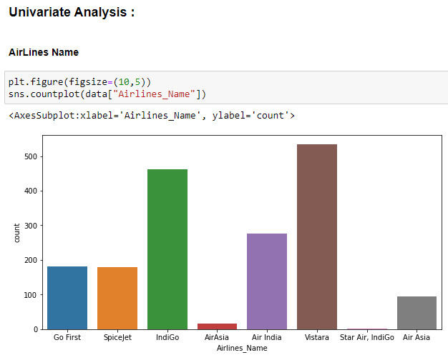
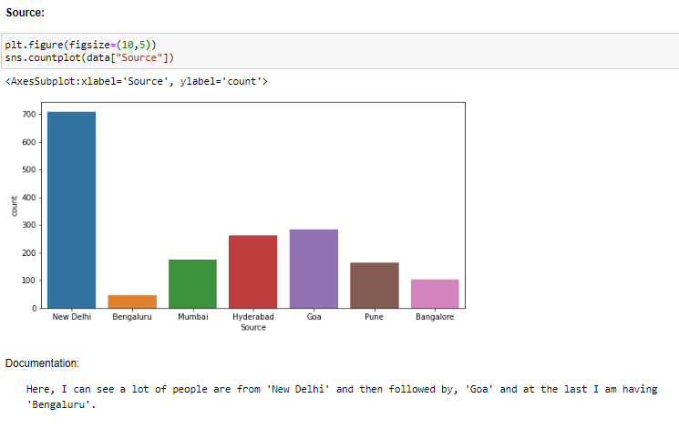

Visualization

Slide 17
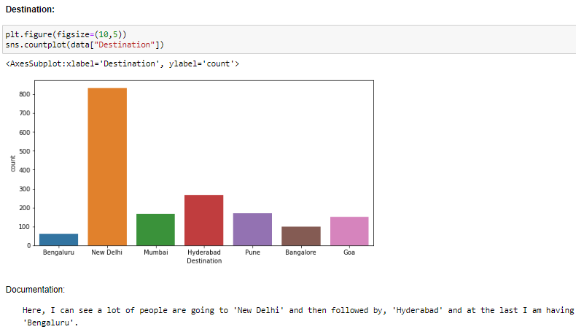
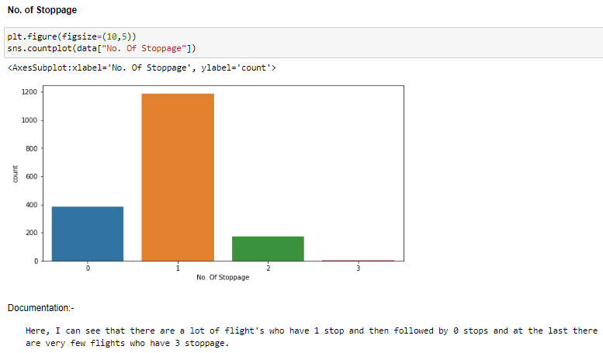

Slide 18
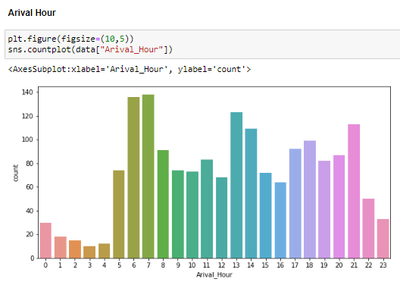
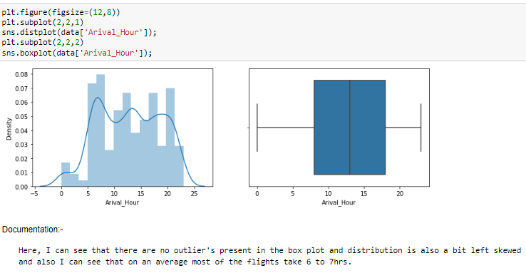

Slide 19
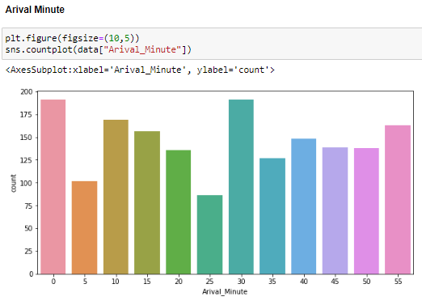
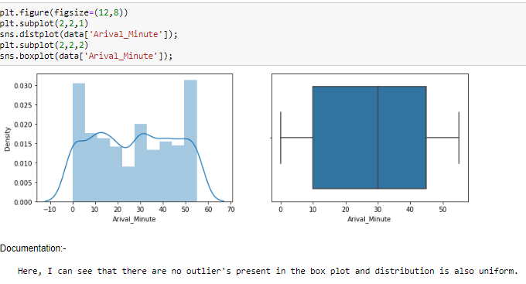

Slide 20
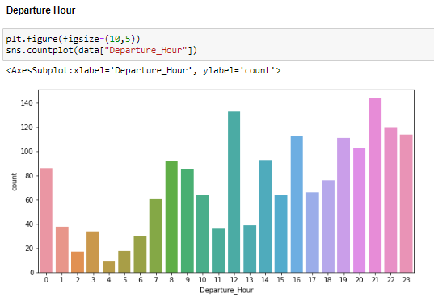
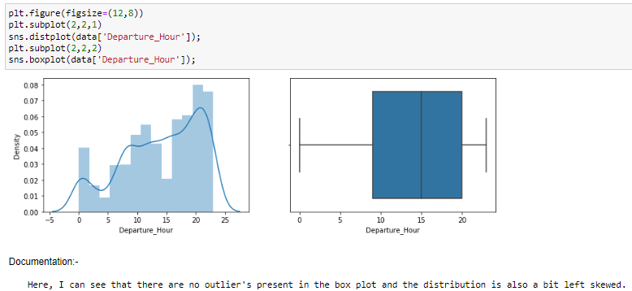

Slide 21
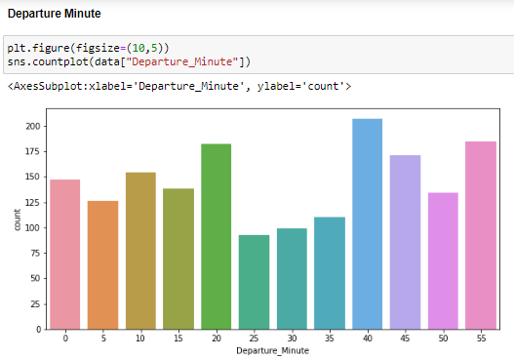
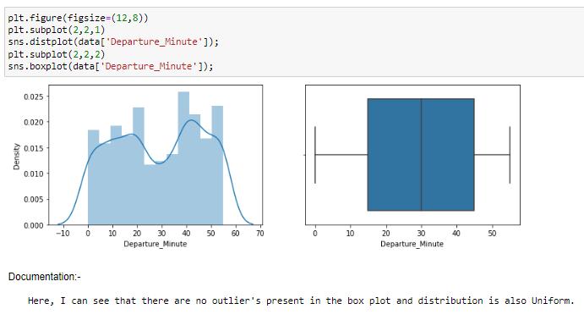

Slide 22
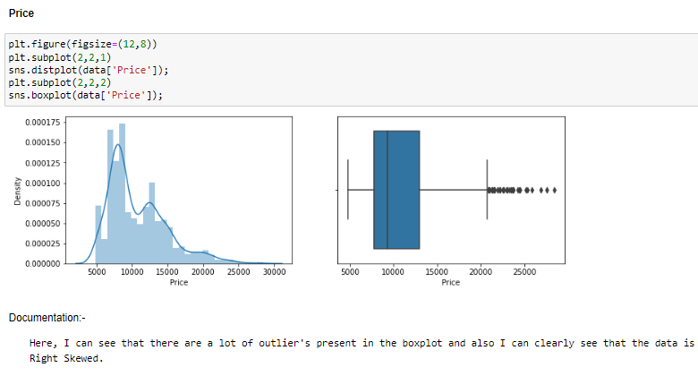

Slide 23
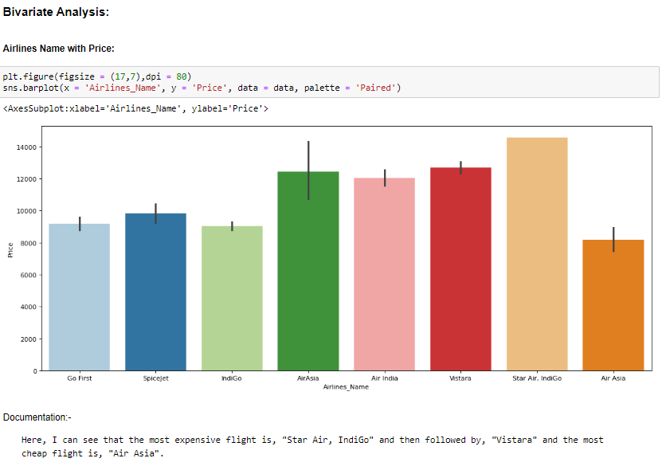

Slide 24
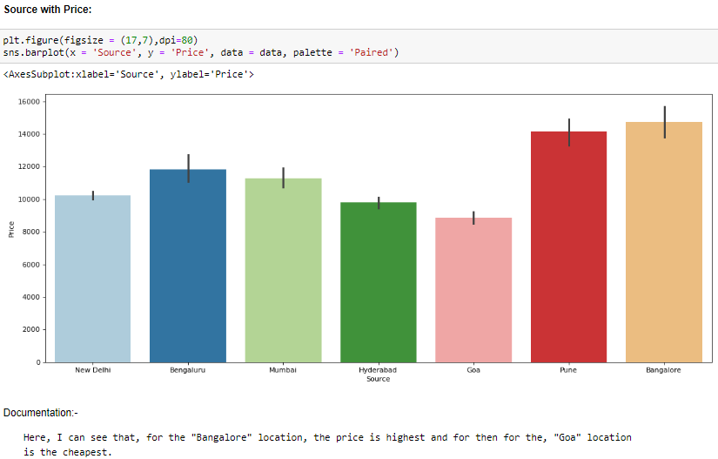
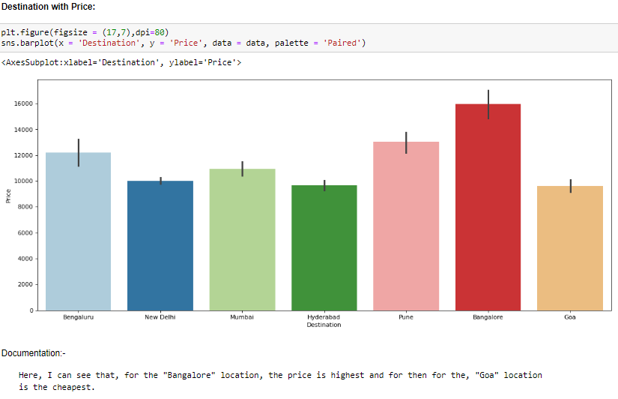

Slide 25
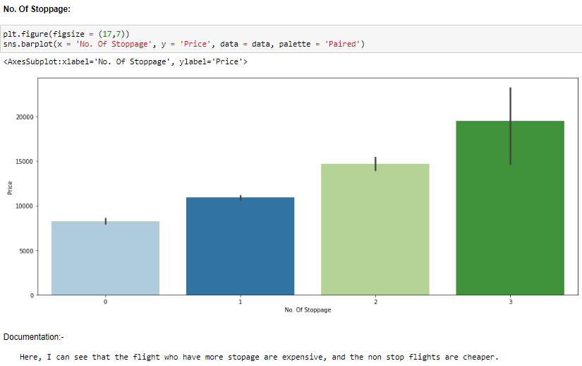
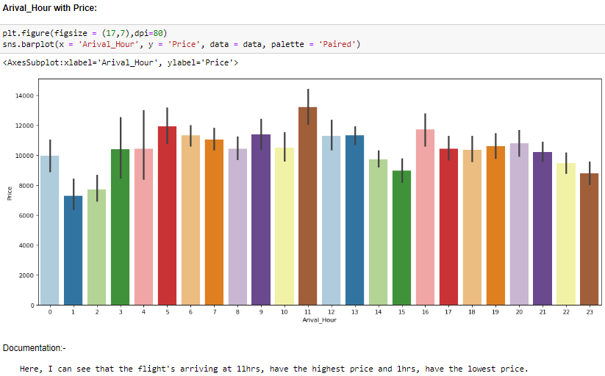

Slide 26
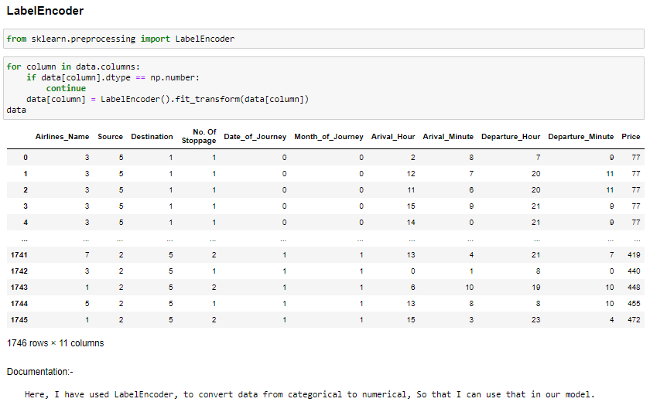
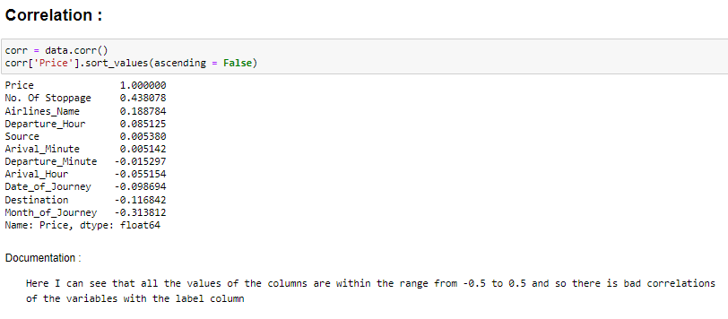

Slide 27
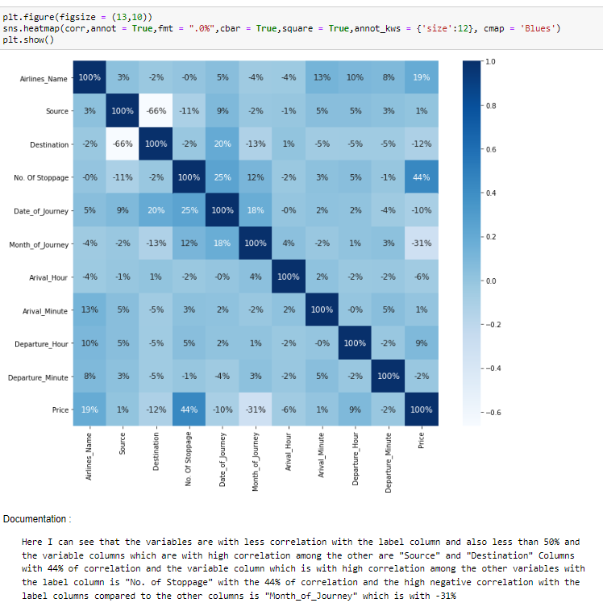

Slide 28
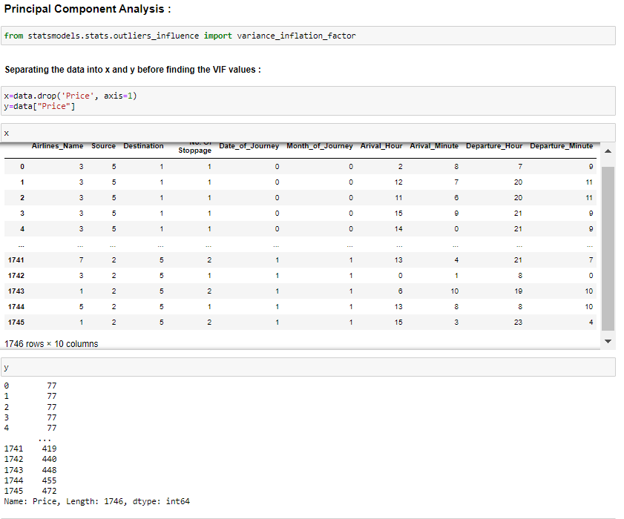
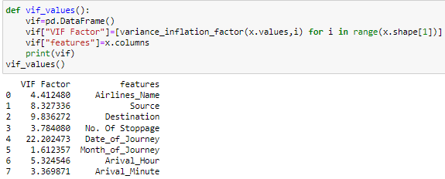
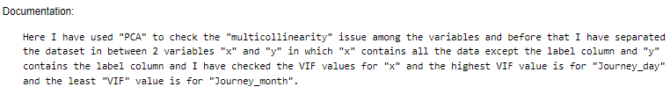

Slide 29
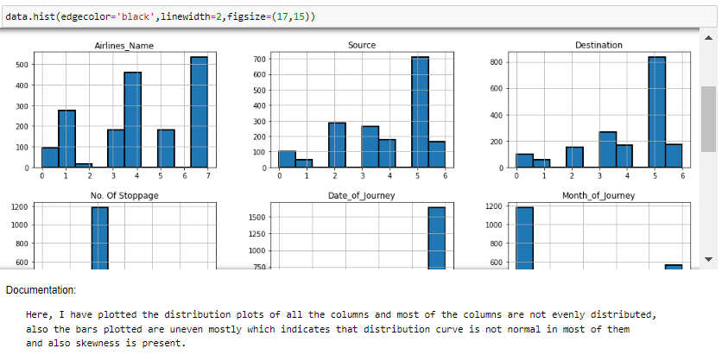
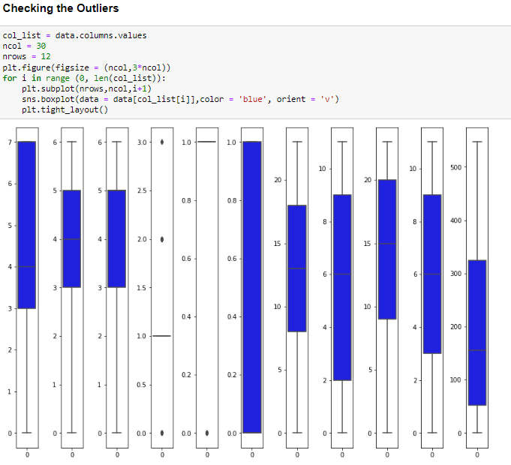

Slide 30
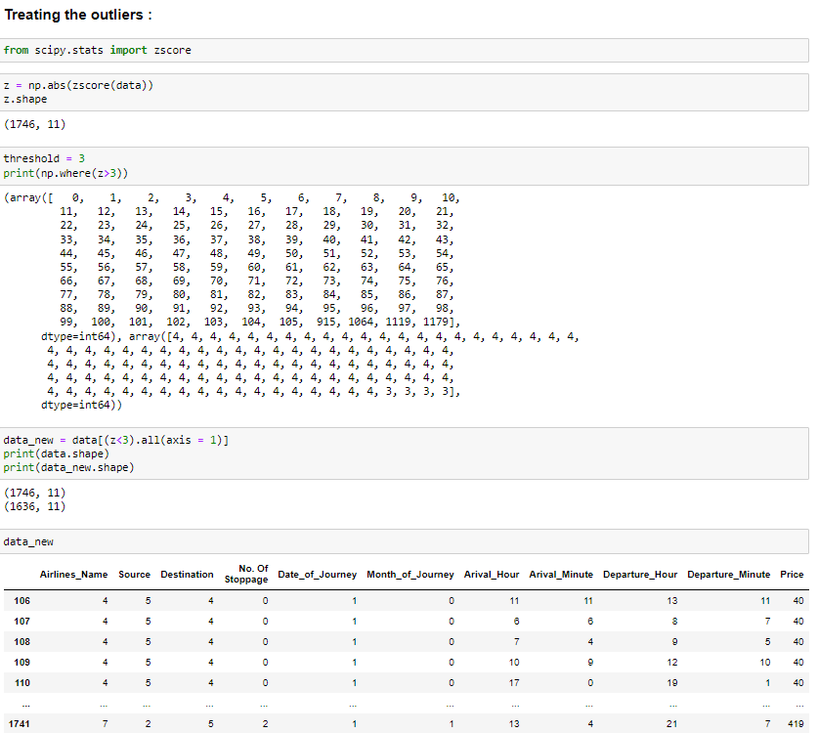
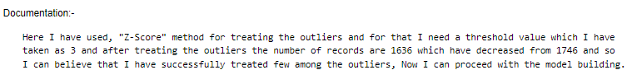

Slide 31


Here I can see that the columns with high skewness is "Destination" and the column with less skewness is "Date_of_Journey" has no skewness at all.

Slide 32



Slide 33


Slide 34


Slide 35



Slide 36



Slide 37



Slide 38



Slide 39



Slide 40



Slide 41




Slide 42



Slide 43
Limitations & Scope of Future
Due to unrealistic flight prices in the website, the error might be higher for certain regions and duration of flight.
Due to this there might be good amount of difference than expected in the future prediction in a new dataset.

Slide 44


